Slide 1
Using APRS
Randy Allen, KAØAZS
Presentation developed by
Randy Allen, KAØAZS
and
Bill Taylor, AC8AA

Slide 2
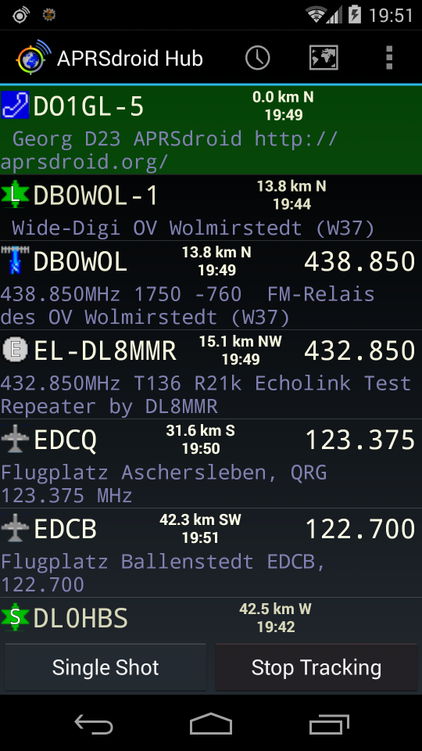
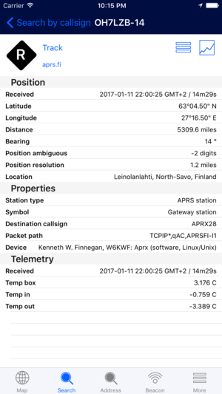
Focus on RF
This presentation will focus on APRS used over amateur analog RF frequencies.
Digital (D-STAR), Web based and Smart Phone applications are not discussed

Slide 3
OVERVIEW
APRS is a real-time tactical digital communications protocol for exchanging information between a large number of stations covering a large (local) area.
As a multi-user data network, it is quite different from conventional packet radio. APRS is different from regular packet in four ways:

Slide 4
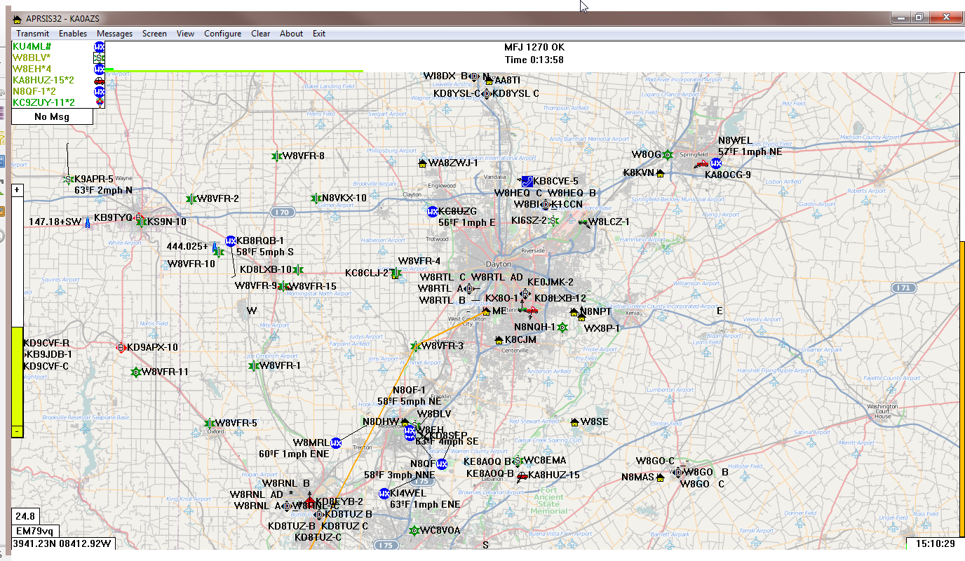
OVERVIEW
FIRST
By the integration of maps and other data displays to organize and display data.

Slide 5
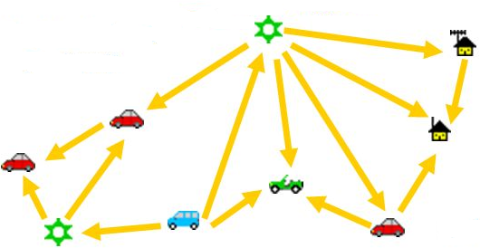
OVERVIEW
SECOND
by using a one-to-many protocol to update everyone in real time.

Slide 6
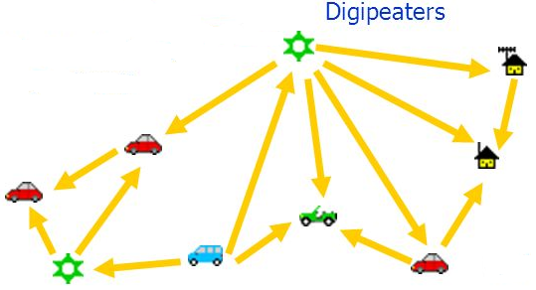
OVERVIEW
THIRD
by using generic digipeating so that prior knowledge of the network is not required.

Slide 7
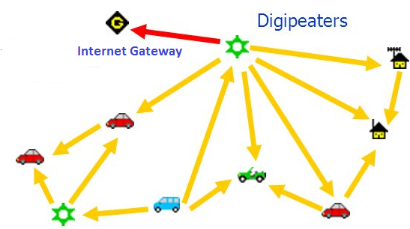
OVERVIEW
FOURTH
by using a worldwide transparent internet backbone, linking everyone worldwide.

Slide 8
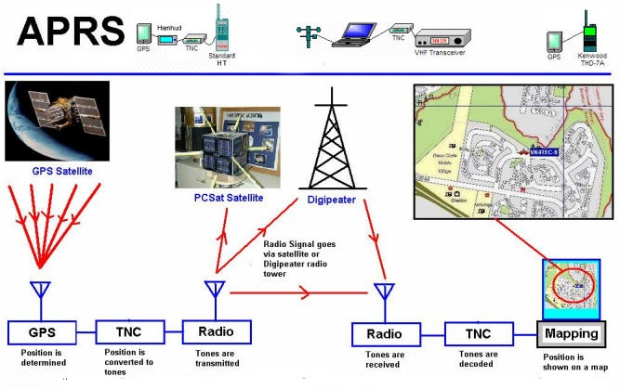
OVERVIEW

Slide 9
CONCEPT
The concept, which dates back to the mid 1980's, is that all relevant information is transmitted immediately to everyone in the net and every station captures that information for consistent and standard display to all participants.
Bob Bruninga, WB4APR is commonly known as the “Father of APRS”.

Slide 10
CONCEPT
Information is refreshed redundantly but at a decaying rate so that old information is updated less frequently than new info.

Slide 11
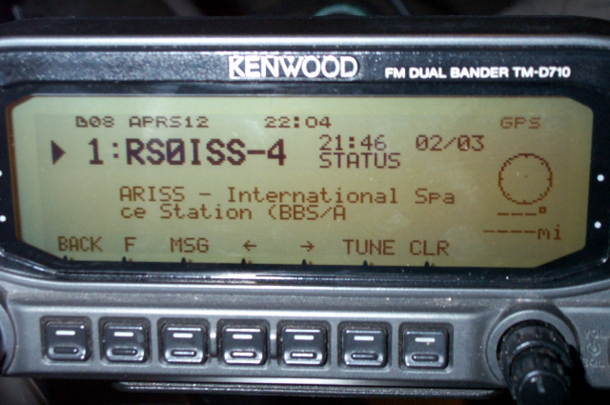
CONCEPT
Since the primary objective is consistent exchange of information between everyone, APRS establishes standard formats for the transmission of POSITION, STATUS, MESSAGES, and QUERIES.

Slide 12
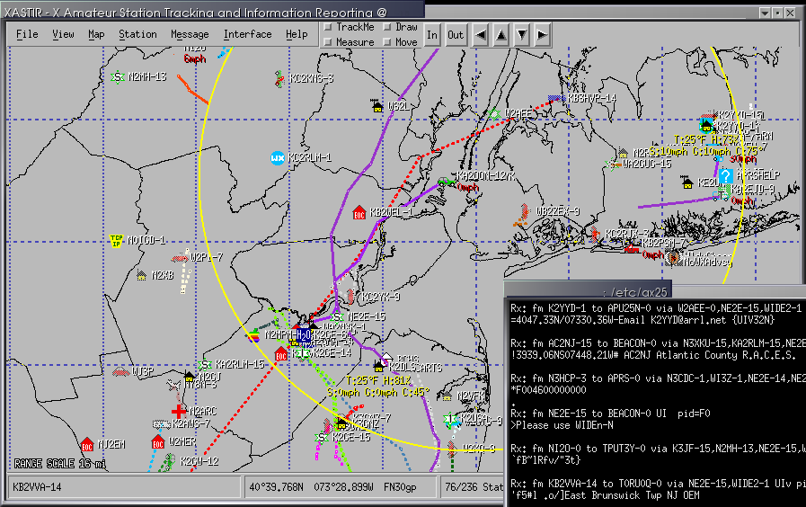
CONCEPT
It also establishes guidelines for display so that users of different systems will still see the same consistent information displayed in a consistent manner (independent of the particular display or mapping system in use)
Xastir (Linux) APRSIS32/CE (Windows)

Slide 13
HOW IT WORKS
APRS turns packet radio into a real-time tactical communications and display system for emergencies and public service applications (and global communications).

Slide 14
HOW IT WORKS
APRS provides universal connectivity to all stations in the net by avoiding the complexity and limitations of a connected network.
It permits any number of stations to exchange data just like voice users would on a voice net.
Any station that has information to contribute simply sends it, and all stations receive it and log it.

Slide 15
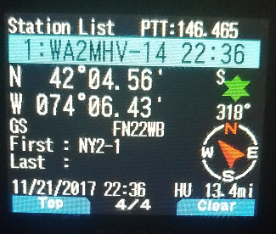
HOW IT WORKS
APRS recognizes that one of the greatest real-time needs at any special event or emergency is the tracking of key assets using packets containing call sign, icon, messages, QSO frequency monitored and much more.

Slide 16
HOW IT WORKS
Where is the Event Leader?
Where are the emergency vehicles?
What's the Weather at various points in the area?
To answer these questions, APRS transmits and captures the location and status of all stations.

Slide 17
HOW IT WORKS
It can be used over any 2-way radio system including HAM, CB, Marine Band, etc.
On VHF, APRS is on 144.39 MHz throughout the North American Continent.
Other countries use other frequencies. Check locally
On HF, APRS uses 10.1 MHz USB on 30 Meters

Slide 18
APPLICATIONS OF APRS
public service events
emergencies
weather nets
direction finding
fox hunting
plotting satellite contacts
monitoring DX clusters.

Slide 19
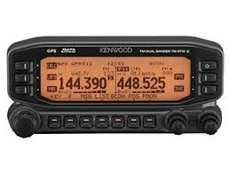
APPLICATIONS OF APRS
Many hams put APRS in their cars and let it run most of the time. Using it this way can allow someone to track your progress on a trip. While traveling, the Voice Alert CQ mode keeps you in touch with other hams and the other local information features gives the traveling ham information of interest.

Slide 20
CONVENTIONS OF APRS
Use your own call sign. For a fixed station, this is enough.
The dash number is a Secondary Station ID (SSID) and it allows you to have multiple APRS stations. It can provide a little additional information about your Station, but the standards are rather loose.
Here is a summary of the recommendations:

Slide 21
CONVENTIONS OF APRS
Note: These are commonly used but may vary by region.
-0 Home Station (IGate) (Same as call sign with no SSID)
-1 Digipeater
-2 Digipeater #2 [or on 70CM]
-3 Digipeater #3
-5 IGate (Not home station)
-6 is for Satellite Operations
-7 APRS HT (Originally Kenwood D7 HT)
-8 is for watercraft
-9 is for Mobiles
-14 is for Truckers
-15 is for HF

Slide 22
APRS ON THE WEB
http://www.aprs.org/ Bob Bruninga's (WB4APR) Site
http://www.aprs.org/APRS-docs/ARTICLES.TXT History of APRS
https://en.wikipedia.org/wiki/Automatic_Packet_Reporting_System Wikipedia
http://info.aprs.net/index.php?title=Main_Page APRS Wiki
http://www.findu.com/ Find-U
https://aprs.fi APRS FI (AKA Google Maps APRS)

Slide 23
APRS ON THE WEB
http://www.aprs-is.net/clientsoftware.aspx
http://info.aprs.net/index.php?title=Software
Lists of Client Software packages
http://aprsisce.wikidot.com/ APRSISCE/32 (Windows)
http://www.ui-view.net/ UI-View (Windows)
http://xastir.org/index.php/Main_Page Xastir (Linux), can be run on MAC

Slide 24
Questions?

